Slide 1
Child and Youth Mental Health and Well-being
Dr. Patti Peterson
Dr. Bill Morrison
University of New Brunswick

Slide 2
Dual Pathway to Child and Youth Well-being
Positive Mental Health Assumptions
Mental Fitness Needs
Youth Mental Health by the Numbers
Stress, Anxiety and Depression in Youth
Home Support Strategies
Outline

Slide 3
Traditional Approaches to Mental Health Care
Mental health programs and services within health, school and community settings have often focused on addressing concerns related to the psychological well-being of children and youth through:
The identification/screening of risk-need factors
The delivery of intervention and support services

Slide 4
Positive Mental Health (PMH)
Recent research in health and education asserts the importance of including a positive view of mental health
PMH involves the recognition that a child or youth’s state of psychological well-being is:
not only influenced by the absence of problems
but also impacted by the existence of positive factors present within youth and their social settings that contribute to positive growth and development

Slide 5
Dual Pathway to Mental Health
Current literature supports the view of a dual pathway model for enhancing mental health:
One pathway with a focus on addressing areas of mental health concern
A second pathway with a focus on promoting environmental factors or practices that contribute to an enhanced sense of well-being and positive development.
The term Positive Mental Health has been used to describe this second pathway.

Slide 6
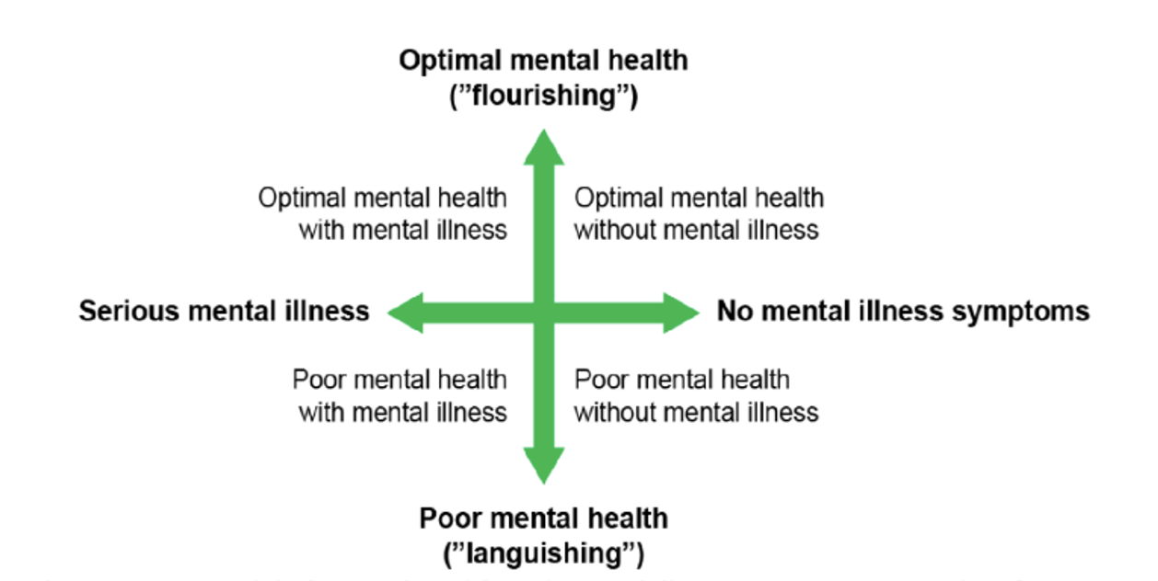
Dimensions of Well-Being
(Keyes,2009)

Slide 7
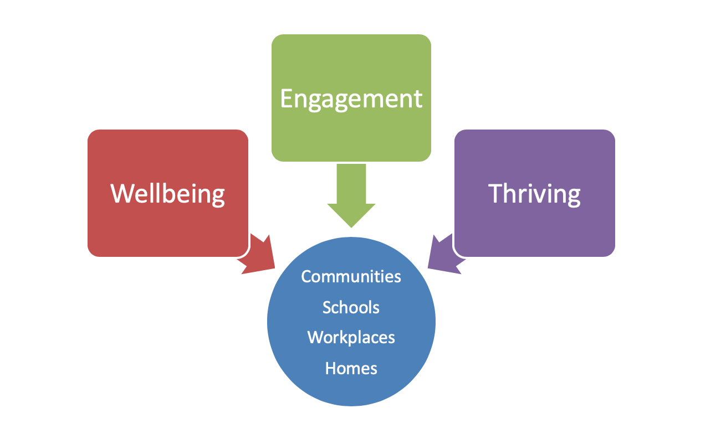
Relationship Practices Impact:

Slide 8
Well-Being Needs
Need for Relatedness
Refers to our need for connection or closeness with family, peers and other significant individuals
--------------
“I belong or am part of my home or school community.”
“I feel included, encouraged and supported by others.”

Slide 9
Relatedness Practices
Welcome
Exchanges
Check-ins

Slide 10
Well-Being Needs
Need for Competency
Refers to our need for being valued and using our strengths to achieve personal goals
--------------
“I have strengths and gifts that are recognized by others”
“When I use my strengths to meet my goals, I feel a sense of worth and accomplishment.”

Slide 11
Competency Practices
Valuing Strengths
Engaging Strengths
Building Confidence

Slide 12
Well-Being Needs
Need for Autonomy Support
Refers to our need to have voice and be active participants in making choices or decisions about daily activities.
--------------
“ I am able to participate in decisions about things that are important to me and others.”
“I feel hopeful because others support me in being an active participant in making choices.”

Slide 13
Autonomy Support Practices
Voice
Choice
Collaboration

Slide 14
An estimated 1.2 million children and youth in Canada are affected by mental health concerns
By age 25, approximately 20% of Canadians will have developed mental health concerns
70% of mental health concerns have their onset during childhood or adolescence
Youth Mental Health by the Numbers
Mental Health Commission of Canada
Statistics Canada

Slide 15
Stress, Anxiety and Depression in youth
Stressful events and situations can contribute to or intensify mental health concerns. These include such things as:
Stressful peer relationships
Family-related concerns
Physical health issues
Isolation and/or loneliness (such as experienced during Covid!)
Significant or multiple life changes
Youth become overwhelmed when they have a feeling of helplessness and don’t know how to change or take control of their circumstances.

Slide 16
Many children and youth will exhibit different moods, thoughts and behaviours at various times that can be part of normal development. These include:
getting significantly lower marks in school
avoiding friends and family
having frequent outbursts of anger
changes to sleeping or eating habits
acting out or rebelling against authority
drinking and/or using drugs
not doing the things they used to enjoy
worrying frequently
experiencing frequent mood swings
not being concerned with their appearance
being obsessed with weight
lacking energy or motivation
increased risk-taking behaviour
feeling very down
Province of Ontario

Slide 17
While these characteristics and behaviours are often part of natural growth and development, they may be signs of an underlying mental health concern if they:
are increasingly intense
persist over long periods of time
are inappropriate for the child’s age
interfere with the child’s life
Province of Ontario

Slide 18
Home Support Strategies
Home Support Strategies
Anxiety
Depression
Please refer to the handouts accompanying this presentation.

